Slide 1
LECTURE 22
Event Handling

Slide 2
EVENT, EVENT SOURCES AND EVENT LISTENER
Event:
An event describes a state change in a source.
It can be generated as a consequence of a person interacting with elements in a GUI.
May also occur that are not directly caused by interaction with a user interface.
Example: timer expires, a software or hardware failure, etc

Slide 3
EVENT, EVENT SOURCES AND EVENT LISTENER
Event source:
  Event sources report on events
  When an event occurs, the event source notifies all event listeners
Event listener:
  An object that is notified when an event happens
  It must be registered with one or more sources to receive notifications.
  It must implement methods to receive and process notification.
  These methods are defined in a set of interface in java.awt.event.
  Any object may receive and process events if it provides an implementation of this interface. event occurs
  When an event occurs, the event source calls the appropriate methods of all associated event listener.

Slide 4
SOME TYPICAL COMPONENT EVENT LISTENERS
Act that results in event | Listener
User clicks a button, presses return while typing in a text field, or chooses a menu item | ActionListener
User closes, quit, activated or deactivated a window | WindowListener
User presses a mouse button while the cursor is over a component | MouseListener
User moves the mouse over a component | MouseMotionListener
Component becomes visible, hidden, moved, resized | ComponentListener
Component gets the keyboard focus | FocusListener
Table or list selection changes | ListSelectionListener

Slide 5
EVENTS, EVENT SOURCES, AND EVENT LISTENERS-EXAMPLE
Example: Use JButton components for buttons; attach an ActionListener to each button
ActionListener interface:
Need to supply a class whose actionPerformed method contains instruc-tions to be executed when button is clicked
public interface ActionListener
{
void actionPerformed(ActionEvent event);
}

Slide 6
EVENTS, EVENT SOURCES, AND EVENT LISTENERS
event parameter contains details about the
event, such as the time at which it occurred
Construct an object of the listener and add it
to the button:
ActionListener listener = new ClickListener();
button.addActionListener(listener);

Slide 7
EXAMPLE
import javax.swing.*;
import java.awt.event.*;
class clicklistener implements ActionListener
{
public void actionPerformed(ActionEvent e)
{
System.out.println("I was clicked.");
}
}
public class button_tst
{
public static void main(String args[])
{
JFrame frame = new JFrame("Button Application");
JPanel panel = new JPanel();
JButton button = new JButton("!Click Me");
ActionListener listener = new clicklistener();
button.addActionListener(listener);
frame.setContentPane(panel);
panel.add(button);
frame.setSize(200,200);
frame.setDefaultCloseOperation(JFrame.EXIT_ON_CLOSE);
frame.setVisible(true);
}
}

Slide 8
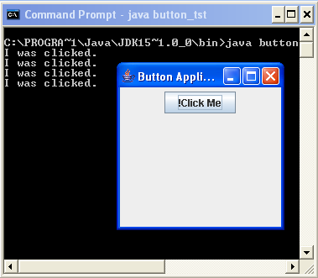
OUTPUT

Slide 9
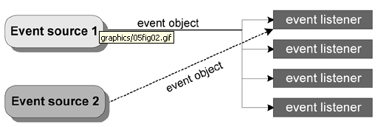
EVENT MODEL-EVENT DELEGATION MODEL
A program can create one listener per event source.
A program can have a single listener for all events from all sources.
A program can even have more than one listener for a single event source.

Slide 10
EVENT OBJECT
Event object is the parameter of the event listener method.
Different event objects are subclass of EventObject class in java.util.
Example-ActionEvent, MouseEvent, ListSelectionEvent etc.
Defines two useful methods:
1. Object getSource()-returns the object on which the event is initially occurred.
2. String toString()- returns a string representation of the EventObject.
Often, an event class defines methods that return information about the event.

Slide 11
EVENT OBJECT
Import java.awt.event. It contains AWTEvent, a subclass of EventObject and superclass of all AWT based event classes, such as- ActionEvent, MouseEvent, ListSelectionEvent, etc.
EventObject
java.util
AWTEvent
Java.awt.event
ActionEvent
MouseEvent

Slide 12
SOME COMMONLY USED EVENT CLASSES
Event Class | Description
ActionEvent | A button is pressed, menu item selected, a list item is double clicked
ComponentEvent | A component is hidden, moved, resized or become visible
KeyEvent | When an input is received from keyborad
MouseEvent | The mouse is dragged, moved, clicked, pressed or released
TextEvent | The value of a text field is changed
WindowEvent | A window is activated, closed, deactivated, opened or quit
ItemEvent | A check box or list item is clicked.

Slide 13
EVENT ADAPTER
Some listener interface contains more than one method. Example-
public class MyClass implements MouseListener {
public void mousePressed(MouseEvent e) { } /* Empty method definition.
public void mouseReleased(MouseEvent e) { } /* Empty method definition.
public void mouseEntered(MouseEvent e) { } /* Empty method definition.
public void mouseExited(MouseEvent e) { }
public void mouseClicked(MouseEvent e)
{ ...//Event listener implementation goes here... } }
The resulting collection of empty method bodies can make code harder to read and maintain.

Slide 14
EVENT ADAPTER
the API generally includes an adapter class for each listener interface with more than one method. It implements the empty versions of all interface methods.
To use an adapter, you create a subclass of it and override only the methods of interest.
Example:
public class MyClass extends MouseAdapter {
...
someObject.addMouseListener(this);
...
public void mouseClicked(MouseEvent e) { ...//Event listener implementation goes here... }
}

Slide 15
INNER CLASS
We can put the class definition inside the method or class that needs it.
Example:
public class MyClass extends Applet {
...
someObject.addMouseListener(new MyAdapter());
...
class MyAdapter extends MouseAdapter {
public void mouseClicked(MouseEvent e) { ...//Event listener
implementation goes here... }
}

Slide 16
ANONYMOUS INNER CLASS
Inner class without name.
make code easier to read because the class is defined where it is referenced.
Example:
public class MyClass extends Applet {
...
someObject.addMouseListener(new MouseAdapter() {
public void mouseClicked(MouseEvent e) { ...//Event listener implementation goes here... } });
... } }

Slide 17
Chapter 22 of your text book.

